Slide 1
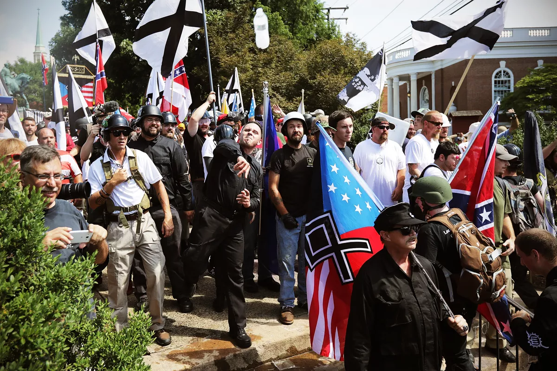
Group-Based
Nostalgia
White Collective Action
Racial
Entitlement
Toxic White Identity
Retroactive Ingroup Social Comparison
System Ambivalence
Racial BIRGing

Slide 2
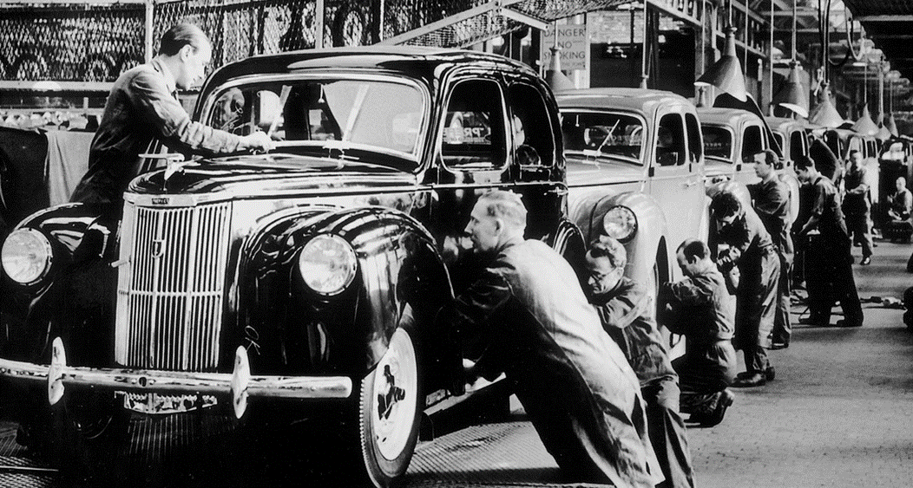
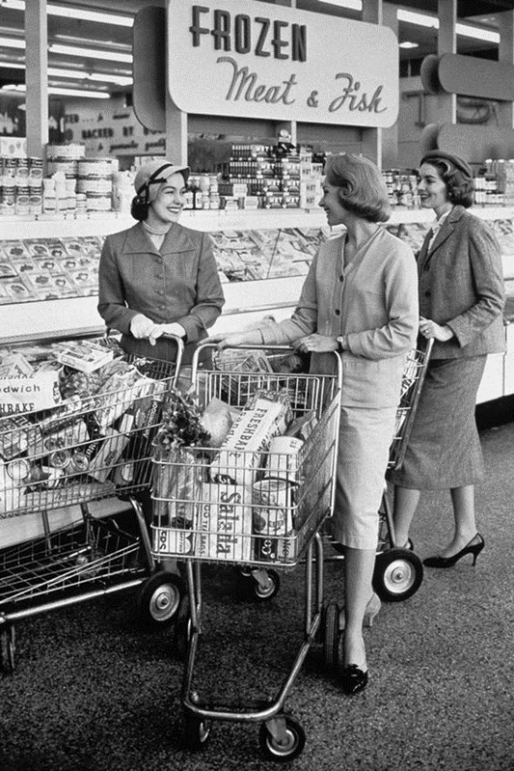
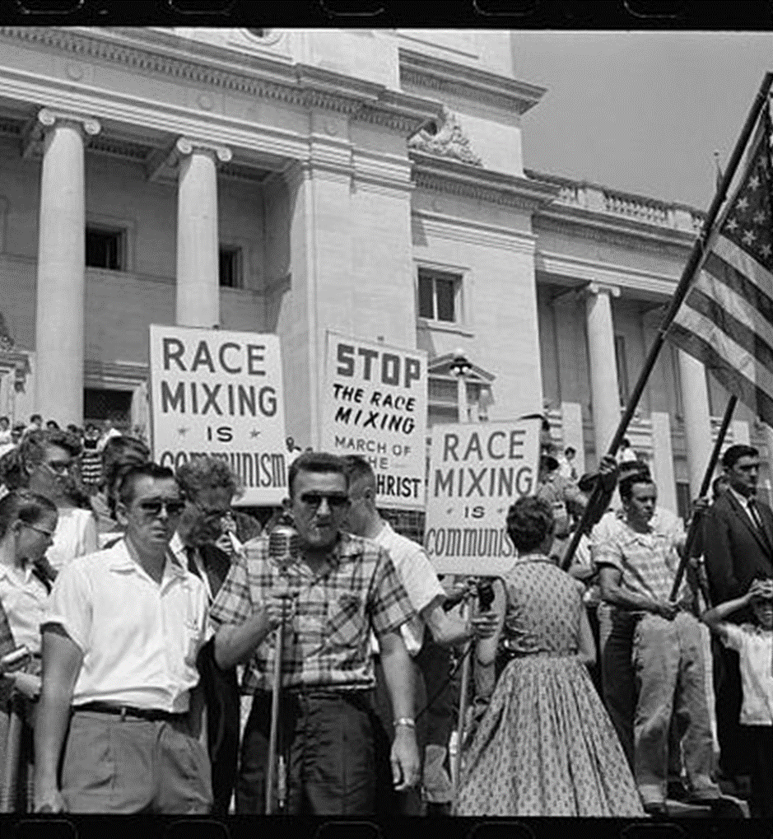
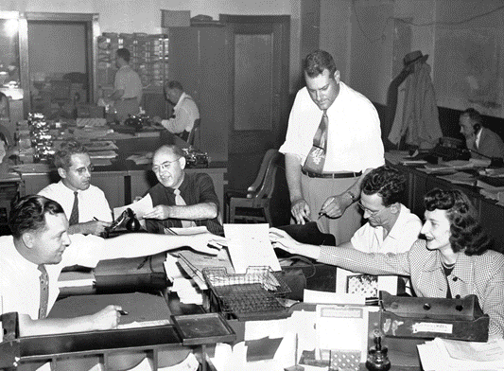
The Good Ol’ Days: White Identity, Group-Based Nostalgia and the Perpetuation of Racial Extremism
Christine Reyna¹, Michael Zarate², & Angel Armenta²
¹DePaul University; ²University of Texas, El Paso

Slide 3
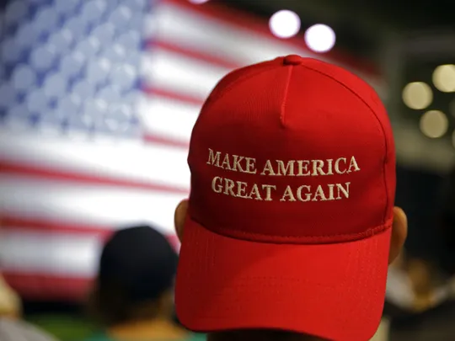
Nostalgia
A sentimental longing or wistful affection for the past, typically for a period or place with happy personal associations
For those in transition, the past reflects a safer, more predictable time
2 manifestations of nostalgia (Boym, 2007)
Reflective nostalgia: wistful emotions associated with memories
Restorative nostalgia: A desire to recreate the past

Slide 4
Group-Based (Collective) Nostalgia
Positive, wistful feelings associated with thinking about oneself in terms of one’s group membership (see Wildschut, Bruder, Robertson, van Tilburg, & Sedikides, 2014 for review)
Foster a renewed sense of social identity by reconnecting people to shared experiences and cultures (Smeekes, Verkuyten, & Martinovic, 2015)
Can cement bonds between people with shared experiences (e.g., Brown & Humphreys, 2002)

Slide 5
“Toxic” Group-Based Nostalgia
National nostalgia → beliefs that native Dutch are entitled to own or rule their country (Autochthony) and predicted opposition to Muslim immigrants’ rights (Smeekes et al., 2015)
Community/neighborhood nostalgia → Whites’ endorsement of colorblind ideologies and beliefs about White victimization (Maly, Dalmage & Michaels, 2012)

Slide 6
Present Research
Study 1: Test the relationship between national nostalgia and perceptions that Latinx immigrants pose realistic and symbolic threats to America
Study 2: Test the relationship between racial nostalgia and endorsement of extreme anti-immigrant policies and White nationalist ideologies, and its mediating role linking White identity to these beliefs

Slide 7
STUDY 1: NATIONAL NOSTALGIA

Slide 8
Study 1 Methods
N = 147 (F: 57; M: 90) White Americans from Mturk
44% moderately to very socially conservative; 59% moderately to very fiscally conservative
Completed an anonymous survey about beliefs about America
National Nostalgia (6-items; α = .91; adapted from Smeeks et al., 2015)
e.g., “How often do you bring to mind nostalgic experiences related to the way the United States was in the past?” and “…how much you miss: The way American society was in the past”
1 = Never…5 = Always

Slide 9
Anti-Immigrant Attitudes
Anti-Immigrant: Realistic Threat (5 items: α = .94)
E.g., “Immigrants are a threat to national security.” and “Immigrants are a burden on American taxpayers.”
1 = Strongly disagree; 7 = Strongly agree
Anti-Immigrant: Symbolic Threat (4 items: α = .90)
E.g., “Immigrants’ culture(s) dilutes American culture.”
1 = Strongly disagree; 7 = Strongly agree

Slide 10
National Nostalgia Predicts Anti-immigrant Attitudes
Variable | Predicting Realistic Threat |  | R²
 | Step 1 | Step 2
National Nostalgia | β = .57*** | β = .34*** | .72
Social Conservatism |  | β = .39***
Fiscal Conservatism |  | β = .14^{n.s.}

Slide 11
National Nostalgia Predicts Anti-immigrant Attitudes
Variable | Predicting Realistic Threat |  | R²
 | Step 1 | Step 2
National Nostalgia | β = .57*** | β = .34*** | .72
Social Conservatism |  | β = .39***
Fiscal Conservatism |  | β = .14^{n.s.}
Variable | Predicting Symbolic Threat |  | R²
 | Step 1 | Step 2
National Nostalgia | β = . 64*** | β = . 43*** | .76
Social Conservatism |  | β = .42***
Fiscal Conservatism |  | β = .05^{n.s.}

Slide 12
Summary
Longing for America’s past predicts beliefs that immigrants pose both realistic and symbolic threats to America beyond conservative ideology.
It is unclear if being nostalgic for America’s past means being nostalgic for America’s WHITE past
The role of White identity and the nostalgia-anti-immigrant association is unclear

Slide 13
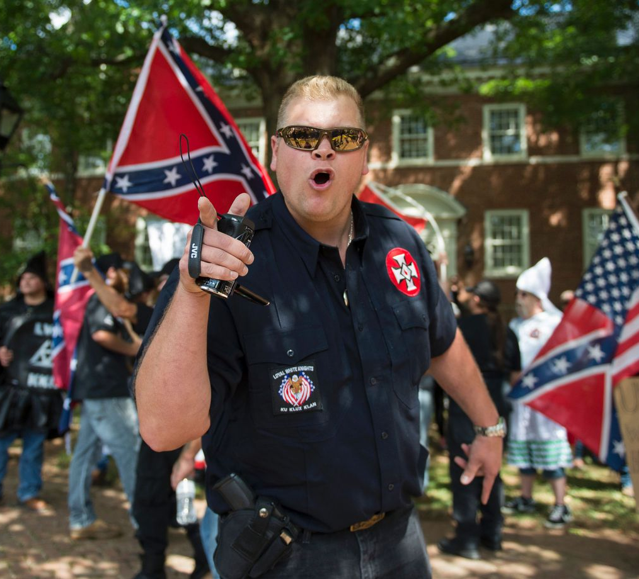
Study 2: Racial Nostalgia

Slide 14
Study 2 Methods
N = 158 (F: 75; M: 83) White Americans from Mturk
68% somewhat to very conservative
Completed an anonymous survey about identity and racial issues in America
Racial identity (Phinney, 1992: 12 items: α = .91); e.g., “I have a strong sense of belonging to my own racial/ ethnic group.”
1 = Strongly disagree; 7 = Strongly agree

Slide 15
Racial/Ethnic Nostalgia
Racial/Ethnic Nostalgia (2 items: r = .59)
“When I think about my racial/ethnic group’s past, I become full of positive emotions.”
“When thinking about my racial/ethnic group, our best days were in the past.”
1 = Strongly disagree; 7 = Strongly agree

Slide 16
Anti-Immigrant Policies & White Nationalism
Anti-Immigrant Policies (3 items: α = .83)
E.g., “In order to deter illegal immigration, the government should separate immigrant children from their parents” and “Our country should use armed force against anyone crossing the border illegally.”
1 = Strongly disagree; 7 = Strongly agree
White Nationalism (5 items: α = .92)
E.g., “One of the problems with America is the decline of Whiteness.” and “In order to maintain White status it is sometimes necessary to use violence towards racial/ethnic minority groups.”
1 = Strongly disagree; 7 = Strongly agree

Slide 17
Nostalgia Mediates Identity-Immigrant Policy Link
Racial
Nostalgia
β =.51***
β =.31***
White
Identity
Anti-
Immigrant
Policy
β =. 18**
(β =. 02 ^{n.s.})
R² = .60; Indirect effect of Nostalgia on policy: β = .16 (CI: .08 to .24).
All effects controlling for ideology

Slide 18
Nostalgia Mediates Identity-White Nationalism Link
Racial
Nostalgia
β =.51***
β =.57***
White
Identity
White Nationalism
β =. 38**
(β =. 10 ^{n.s.})
R² = .56; Indirect effect of Nostalgia on WN: β = .29 (CI: .19 to .40).
All effects controlling for ideology

Slide 19
Summary
White identity’s association with extreme anti-immigrant attitudes and toxic racial ideologies was mediated by idealizing one’s racial past
Broadly, group-based nostalgia can predict negative attitudes, especially if nostalgia is “restorative” to a time of cultural dominance, homogeneity, and racial entitlement

