Slide 1
Group-Based
Nostalgia
White Collective Action
(Racial)
Entitlement
Toxic White Identity
Retroactive Ingroup Social Comparison
System Ambivalence
Racial BIRGing

Slide 2
The Role of (Racial) Entitlement in Intergroup Hostility and White Nationalism
Kara Harris, DePaul University (kharri92@depaul.edu)
Lynn Kannout, Illinois Institute of Technology
Rusty Steiger, DePaul University

Slide 3
Dehumanization

Slide 4
Dehumanization

Slide 5
Dehumanization
Dehumanization: attributing fewer human traits, emotions and experiences onto a group or individual (Kteily et al., 2017)
Mechanistic: Views an individual or group as devoid of emotions, and automaton (Haslam, 2006)
Animalistic: associating animal like traits to a individual or group (Haslam, 2006)
Predictors of animalistic dehumanization
Lack of contact (Hodson & Costello, 2010)
Low empathy
Negative stereotypes/ distorted beliefs
Perceiving groups as inherently beneath your group
(Hodson & Costello, 2010).

Slide 6
Entitlement
Entitlement: person has the belief that they are inherently deserving of privileges or special treatment
Narcissistic Entitlement (Raskin & Terry, 1988)
Heightened aggression
Antisocial traits
Low levels of forgiveness

Slide 7
Entitlement and Dehumanization
Entitlement to my knowledge has not been examined in the dehumanization literature
Believing that a group is beneath you and does not deserve equal treatment can lead into dehumanization

Slide 8
Present Studies
Study 1: Does entitlement among Whites predict dehumanization of marginalized groups?
Study 2: Does dehumanization predict endorsement of white nationalist ideologies and discriminatory policies, and is this relationship driven in part by racial entitlement?

Slide 9
Study 1: Dehumanization and Narcissistic Entitlement

Slide 10
Methods
N = 246 self-identified, White Americans
Age: 19 -81 years of age
Gender: 105 (42.7%) Males, 137 (55.7%) Females
Participants were recruited from Mturk to complete a larger study about groups in society.

Slide 11
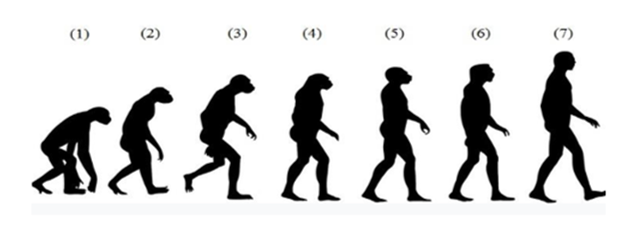
Measures
The Entitlement Subscale was adopted from the larger Narcissistic Personality Inventory (2-items; α = .90, Raskin & Terry, 1988)
Item: “I will never be satisfied until I get all that I deserve”
Item: “I insist upon getting the respect that is due to me”
The Ascent of Man Scale (8-items; Kteily, Bruneau, Waytz, & Cotterill, 2015)

Slide 12
Measures
The Ascent of Man Scale (8-items; adapted from Kteily, Bruneau, Waytz, & Cotterill, 2015)
“People can vary in how human-like they seem. Some people seem highly evolved whereas others seem no different than lower animals. Using the image below as a guide, indicate… how evolved you consider the average member of each group to be.”

Slide 13
Entitlements Effect on Dehumanization of Marginalized Groups
 | Whites | Blacks | Latinos | Asians | Native American | Middle Easterners | Mexicans | Immigrants
Entitlement | -.228*** | -.250*** | -.235*** | -.262*** | -.184** | -.161** | -.184** | -.163**
Partial correlations controlling for Political Ideologies
*p < .05. **p < .01. ***p < .001

Slide 14
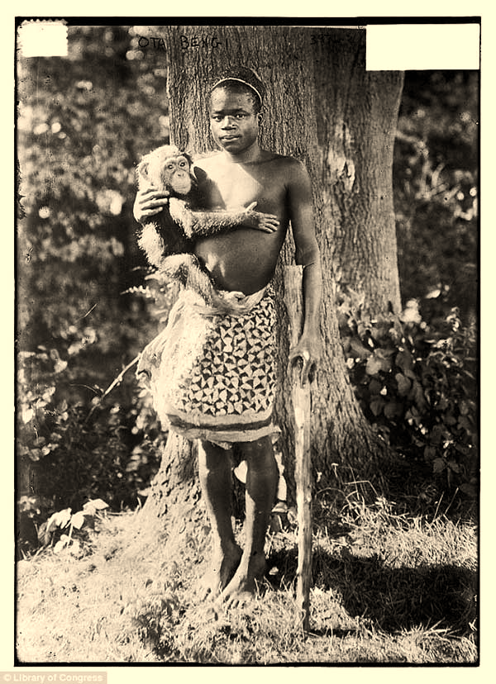
Summary
Feelings of Narcissistic Entitlement are associated with dehumanizing both the minority groups and majority.
The narratives that often emerge from white nationalism dehumanizes minority groups.
Entitlement in a racial context may be relevant in understanding the relation between dehumanization in toxic intergroup attitudes.

Slide 15
Study 2: Racial Entitlement and Dehumanization

Slide 16
Identity-based Entitlement
Group Entitlement (Claassen, 2014)
Identity
National Entitlement (Smeekes et al., 2015)
Aggrieved Entitlement (Kalish & Kimmel, 2010)
“Incels” and gender violence
Mass shooters
Racial Entitlement: the belief that one’s self or group is inherently deserving of privileges or special treatment, because of their race.
Racially motivated attacks or opposition to racial change (e.g., Charleston, Charlottesville)

Slide 17
Present Study
Does dehumanization predict endorsement of white nationalist ideologies and discriminatory policies, and is this relationship driven in part by racial entitlement?

Slide 18
Methods
N = 358 self-identified, White Americans
Age: 19 -73 years of age
Gender: 183 (52.5%) Males, 175 (47.5) Females
Participants were recruited from Mturk to complete a larger study about Racial Identity and the Status of America

Slide 19
Racial Entitlement (α = .91, 10 Items)
1. I feel I am more deserving of good things than others because of my race/ethnicity.
2. Because of my race/ethnicity great things should come to me.
3. I do not deserve special treatment based on my race/ethnicity.
4. People of my race/ethnicity deserve better things in life than others.
5. I deserve respect due to my race/ethnicity.
6. If I lost a job to a person of a different race/ethnicity, I would feel cheated even if they were equally qualified.
7. If a boat was sinking, people of my race/ethnicity deserves to be on the first lifeboat
8. Those of my race/ethnicity should have access to more opportunities (e.g. jobs, education, housing) because we have more to offer.
9. I believe I deserve the advantages given to members of my race/ethnicity.
10. I do not feel entitled to more benefits in society due to my race/ethnicity.
7-point Likert Scale, Strongly Disagree- Strongly Agree

Slide 20
Additional Measures
The Ascent of Man Scale: 6-items (α = .93; Kteily et al., 2015).
White Nationalist Ideologies Scale: 13-items (7-point Likert; α = .93)
“White American culture is what makes this country great”
Discriminatory Policies Scale: 13-items (7-point Likert; α = .88)
“Increasing police patrols in racial/ethnic minority communities is necessary to lower crime.”

Slide 21
Racial Entitlements Effect on Dehumanization of Marginalized Groups
 | Whites | European Immigrants | Latinx | Asians | Muslims | Blacks | Latin American Immigrants | Undocumented Immigrants
Racial Entitlement | -.123** | -.244*** | -.395*** | -.359*** | -.283*** | -.366*** | -.356*** | -.381***
Partial correlations controlling for Political Ideologies
*p < .05. **p < .01. ***p < .001

Slide 22
Racial Entitlement’s Effect on Support for Discriminatory Policies and White Nationalist Ideologies
 | 1 | 2 | 3
1. Racial Entitlement | -
2. White Nat. | .717*** | -
3. Policies | .432*** | .587*** | -
4. Dehumanization | .399*** | .452** | .318***
*p < .05. **p < .01. ***p < .001

Slide 23
Indirect Effect of Racial Entitlement to White Nationalism
Racial Entitlement
White Nationalism
Dehumanize
β = .39**
β = .64***
β = .45***
β = .19**
*p < .05. **p < .01. ***p < .001
R² = .63, 95% CI [.36, .52]

Slide 24
Indirect Effect of Racial Entitlement to Discriminatory Policies
Racial Entitlement
Policies
Dehumanize
β = .39***
β = .25***
β = .23***
β = .13**
*p < .05. **p < .01. ***p < .001
R² = .63, 95% CI [.15, .21]

Slide 25
Summary
Dehumanization of minorities groups is partially due to racial entitlement.
Racial entitlement partially mediates the effect between dehumanization and white nationalism and extremist policies.
(Racial) entitlement may play a more critical role than previously suggested in intergroup hostility and relations.

