Slide 1
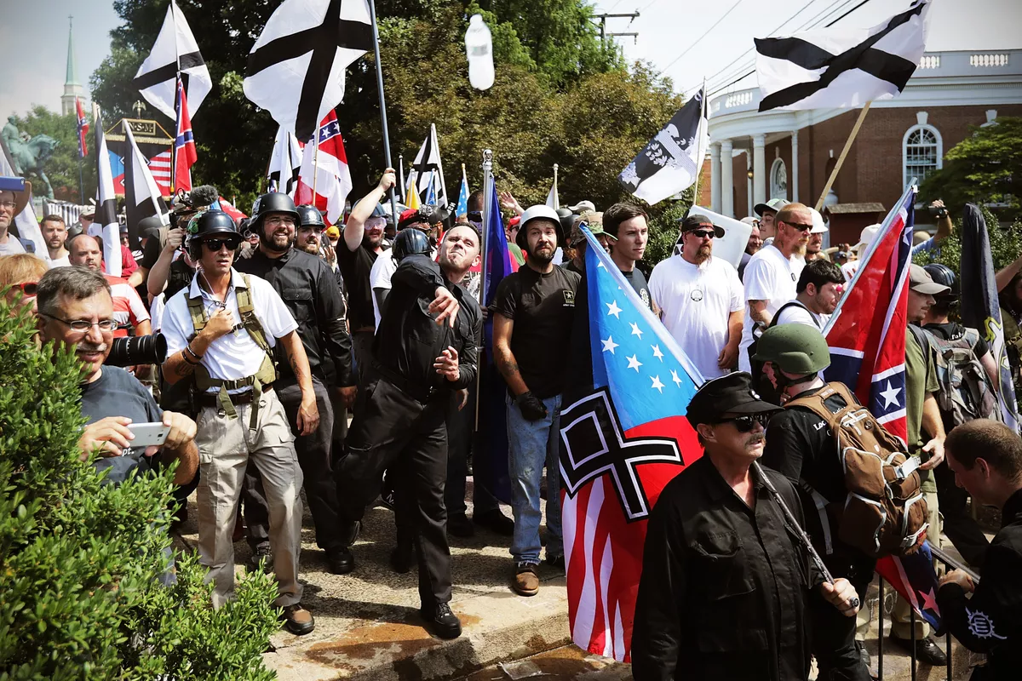
Group-Based
Nostalgia
White Collective Action
Racial
Entitlement
Toxic White Identity
Retroactive Ingroup Social Comparison
System Ambivalence
Racial BIRGing

Slide 2
When equality feels like oppression Examining the relationship between white identity and political violence
James Davis
Benedictine University
Or'Shaundra Benson
College Of DuPage

Slide 3
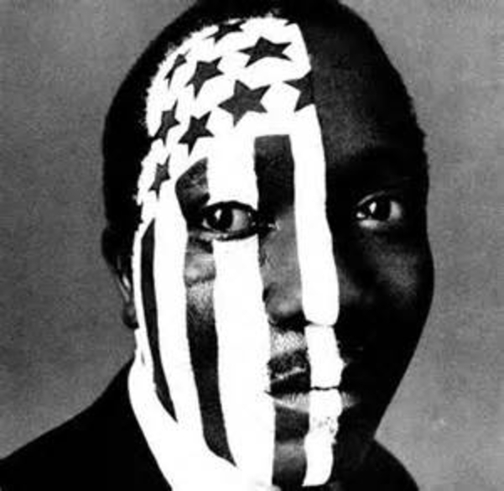
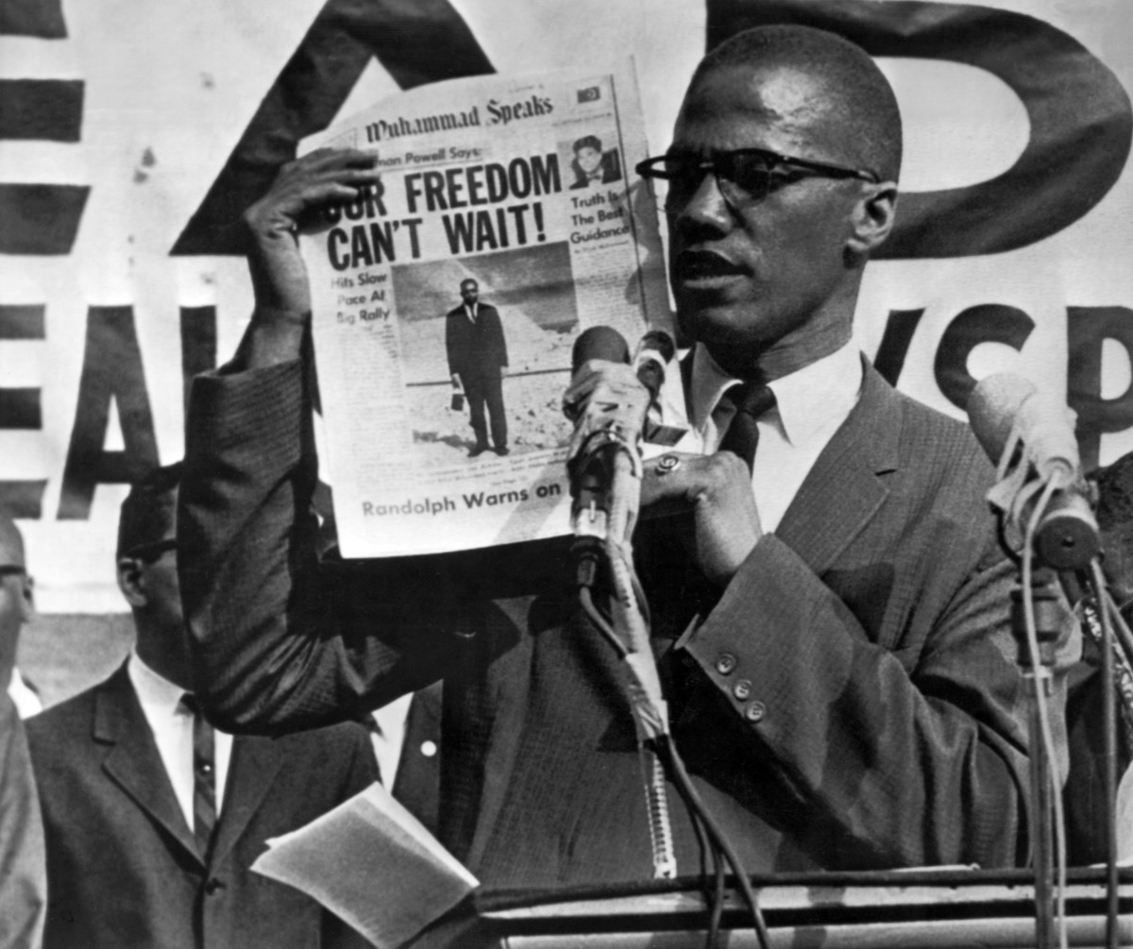
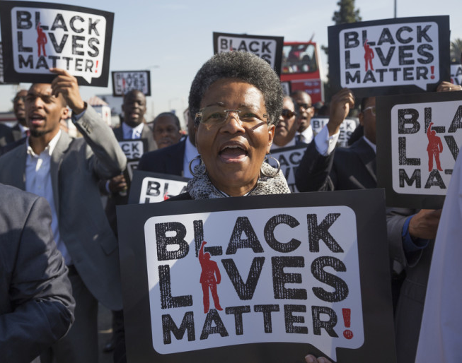
Minority Group Consciousness
(Miller, Gurin, Gurin,& Malanchuk, 1981)
Social identity
Ideological beliefs
Collective action

Slide 4
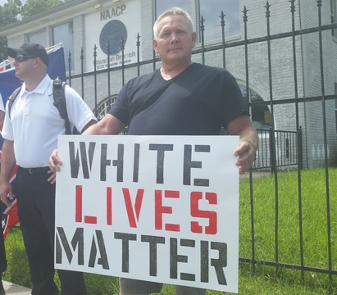
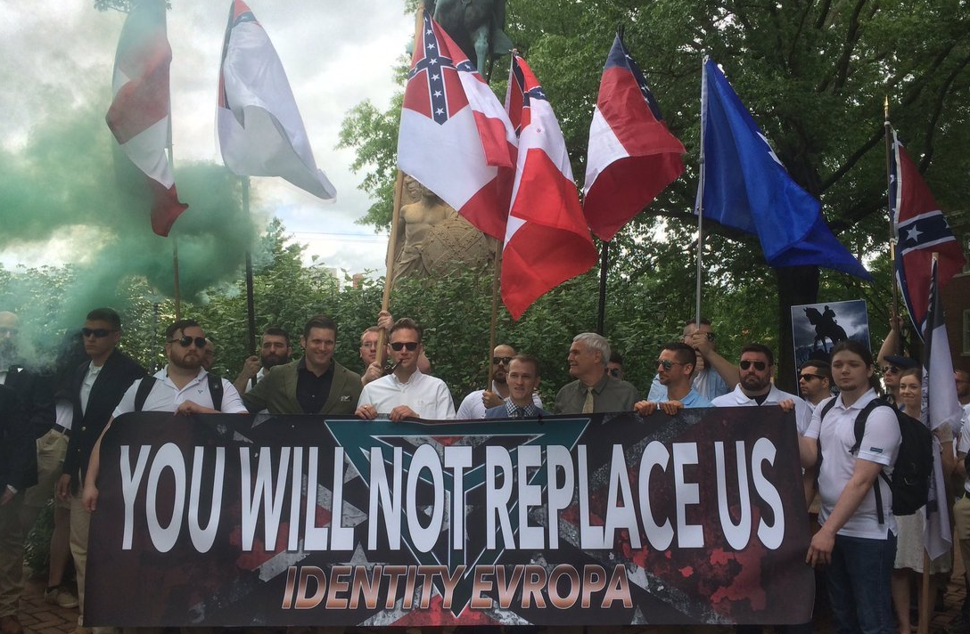
White Group Consciousness
(Jardina 2018)
Social identity
Ideological beliefs
Collective action

Slide 5
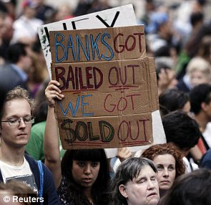
Political Violence
(Bell, Cingranelli, Murdie, & Caglayan, 2013)
Maintaining power
Relative deprivation
Income inequality
(Congressional Budget Office, 2019)

Slide 6
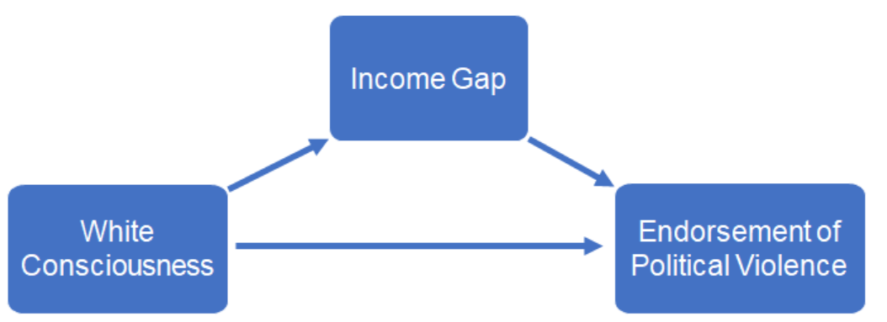
The Current Studies
Research Questions:
?

Slide 7
The Current Studies
Research Questions:
Data
We examine these questions using two nationally representative samples of self identified Whites, the 2016 ANES and the 2018 ANES pilot study
?
?
?

Slide 8
Methods: 2016 ANES
Participants
2016 ANES Study, n = 2307 self identified Whites
Gender: 49.7% male, 50.3% female
Median Age= 52, with a range of 18-91
Median Education was an associates degree with 36.42% having less than an associates and 48.4% with more than an associates degree
Liberalism/Conservatism: 1 Extremely liberal, 7 Extremely conservative

Slide 9
Methods: 2016 ANES
White Consciousness (3 items, Alpha .95; Jardina 2018)
How important is being White to your identity?
How important is it for Whites to work together to change laws unfair to Whites?
1 not at all important, 5 extremely important
How likely is it that many Whites are unable to find a job because employers are hiring minorities instead?
1 not likely; 5 Very likely

Slide 10
Methods: 2016 ANES
Political violence
How much do you feel it is justified for people to use violence to pursue their political goals in this country? 1 not at all, 5 a great deal
Income Gap:
Do you think the difference in incomes between rich people and poor people in the United States today is larger, smaller, or the same as it was 20 years ago? 1 smaller, 2 about the same, 3 larger
Racial resentment (4 items Alpha .88)
Generations of slavery and discrimination have created conditions that make it difficult for Blacks to work their way out of the lower class. 1 strongly agree , 7 strongly disagree

Slide 11
Regression Predicting Political Violence
 | block1 | block2 | block3
 | β | β | β
White Consciousness | .061** | .058** | .055*
Income Gap |  | -.041* | -.044*
Liberalism/Conservatism |  |  | -.053*
Age |  |  | -.100***
Gender |  |  | -.048*
Education |  |  | -.013
Racial resent |  |  | .098***
R² | .004 | .005*** | .025*
p < .05. **p < .01. ***p < .001; weighted for the population

Slide 12
Income Gap Mediation Analysis
Income Gap
β = -.082***
β = -.042*
White Consciousness
Endorsement of Political Violence
β =. 063**
(β =. 059*)
R² = .006; Indirect effect of White Consciousness on Political Violence :
β = .003 (95% CI: -.0004, .0085).

Slide 13
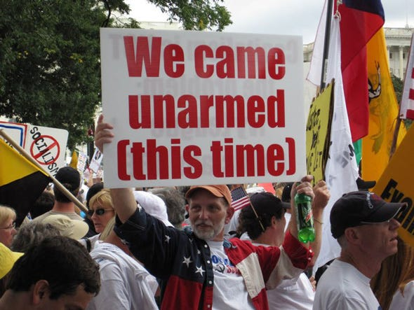
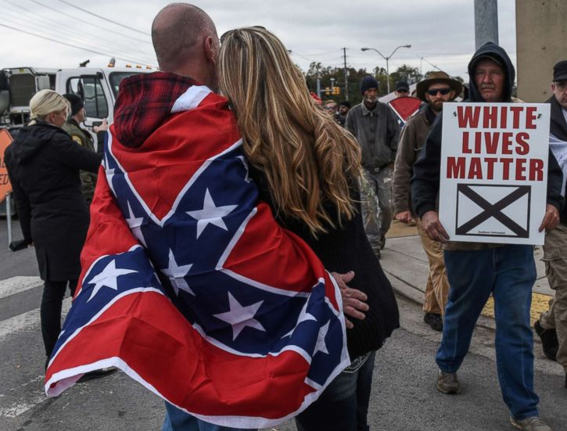
Study 1 Discussion
Increased White Consciousness is associated with increased support for political violence and perceptions of increased income equality.
Some highly identified Whites in the US may feel like an oppressed minority.
Study 2 examines 2018 data to determine if these patterns replicate and persist with other avenues for affecting political change (i.e. democracy).

Slide 14
Study 2 2018 ANES Pilot
Participants
2018 ANES pilot Study, n = 1854 self identified Whites
Gender 45.7% male, 54.3% female
Median Age: 54, with a range of 18-91
Median Education was “some college” 23.4%, with 27.2% below and 49.4% above the median
Liberalism/Conservatism: 1 Extremely liberal, 7 Extremely conservative

Slide 15
Methods: 2018 ANES
White Consciousness (3 items, Alpha .69)
How important is being White to your identity?
How important Whites work together to change laws unfair to Whites?
1 not at all important, 5 extremely important
How likely is it that many Whites are unable to find a job because employers are hiring minorities instead?
1 not likely; 5 Very likely

Slide 16
Methods: 2018 ANES
Income Gap
Do you think the difference in incomes between rich people and poor people is larger, smaller, or the same as it was 20 years ago? 1 smaller, 2 about the same, 3 larger
Racial resentment (4 items Alpha .88)
Generations of slavery and discrimination have created conditions that make it difficult for Blacks to work their way out of the lower class. 1 strongly agree, 7 strongly disagree

Slide 17
Methods: 2018 ANES
Political violence
How much do you feel it is justified for people to use violence to pursue their political goals in this country? 1 not at all, 5 a great deal
Democratic norms (6 items, Alpha .90) How important are each of the following to the United States maintaining a strong democracy?
“The executive, legislative, and judicial branches of government keep one another from having too much power 1 not at all, 5 a great deal

Slide 18
Regression Predicting Democratic Norms
 | block1 | block2 | block3
 | β | β | β
White Consciousness | -.191*** | -.141** | -.070*
Income Gap |  | .389*** | .289***
Liberalism/Conservatism |  |  | -.019
Age |  |  | .155***
Gender |  |  | -.016
Education |  |  | .276***
Racial resent |  |  | -.112*
R² | .037 | .186*** | .299***
p < .05. **p < .01. ***p < .001; weighted for the population

Slide 19
Regression Predicting Political Violence
 | block1 | block2 | block3
 | β | β | β
White Consciousness | .082*** | .054** | .147***
Income Gap |  | -.181*** | -.190***
Liberalism/Conservatism |  |  | -.144***
Age |  |  | -.236***
Gender |  |  | -.035
Education |  |  | -.127
Racial resent |  |  | -.043
R² | .007 | .038*** | .114***
p < .05. **p < .01. ***p < .001; weighted for the population

Slide 20
Income Gap Mediation Analysis
Income Gap
β = -.21***
β = -.18*
White Consciousness
Endorsement of Political Violence
β = .10***
(β = .06**)
R² = .044; Indirect effect of White Consciousness on Political Violence:
β = .039 (95% CI: .026, .056).

Slide 21
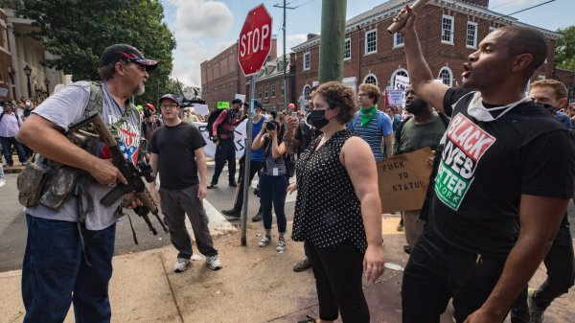
Then and Now?
The effect of White Consciousness on political violence has more than doubled since 2016 and is significantly greater in 2018
2016 β a = .055, 2018 β = .147 , t(4140) = 3.53, p < .001)

Slide 22
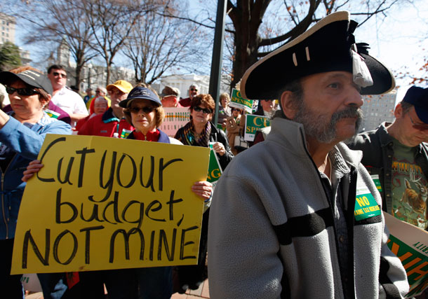
Discussion
Income inequality is on the rise in the US.
Paradoxically, the perception of equality partially drives political violence among Whites.
A Toxic White Identity may involve the belief that Whites are an oppressed minority.
How are Whites oppressed in an environment where incomes are purportedly more equal?

Slide 23
Discussion
When equality feels like oppression
Income before transfers and taxes
Income after transfers and taxes

